Slide 1

Welcome

Slide 2
Ray Tracing Haopeng Wang Mohammad Hamza

Slide 3
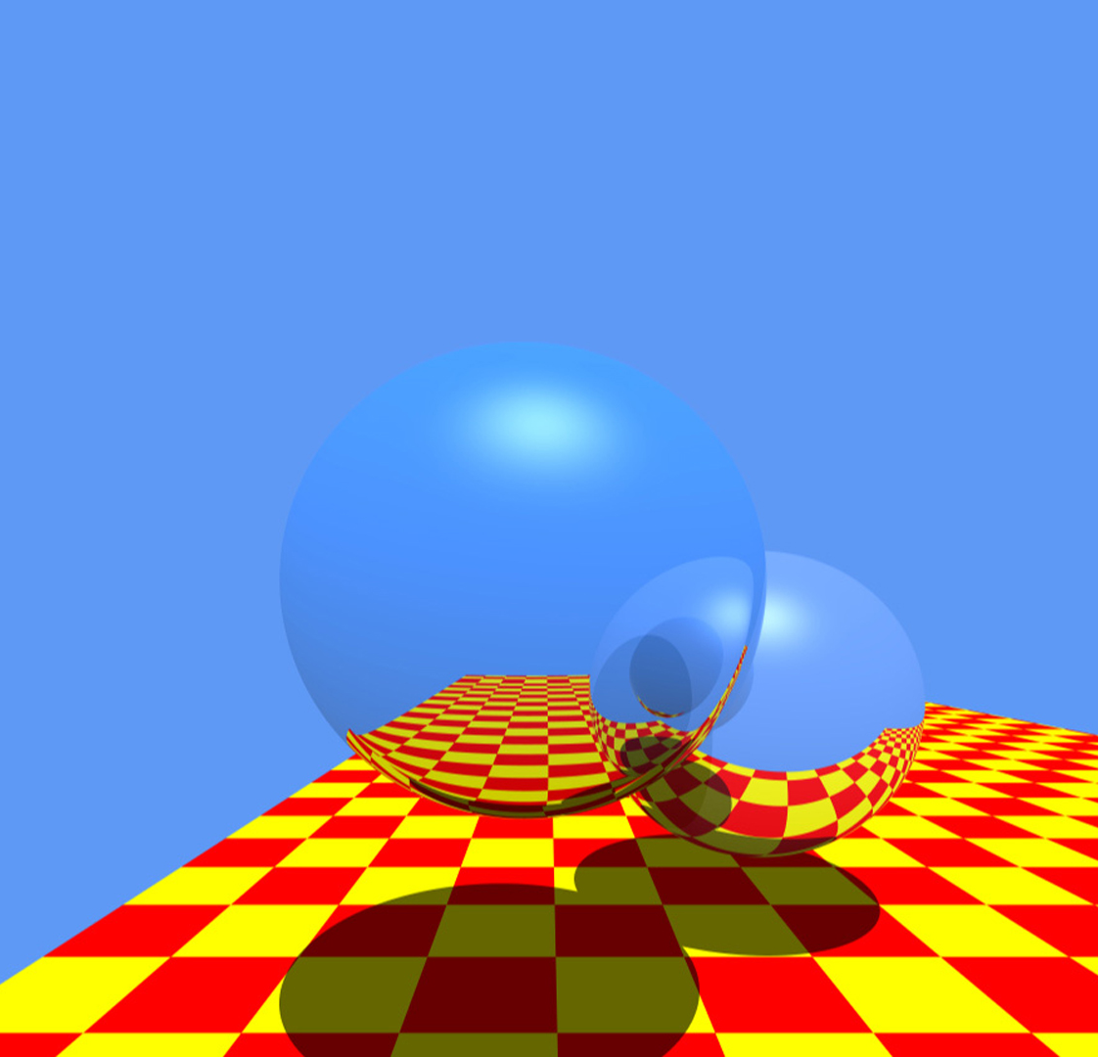
Outline
01
What is ray tracing?
02
Flow Chart
03
Project details
04
GPU accelerate
05
sightpy Library
06
Comparison & Summary
Image from J. Turner Whitted
07
Reference

Slide 4
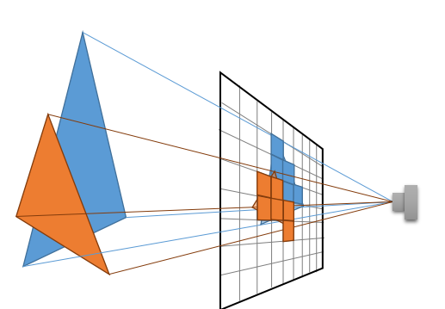
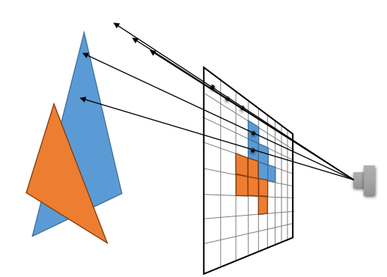
1. What is ray tracing?
Rasterization(before):
For each triangle t
find pixels inside t
shade pixel with its color
Shade till the pixels leave t.
Ray tracing:
For each pixels p
cast a ray through pixel p
shade p
The color is depends on what the Ray intersects with and reflected to.
Image from Computer Graphics slides
Notes:
Difference:

Slide 5
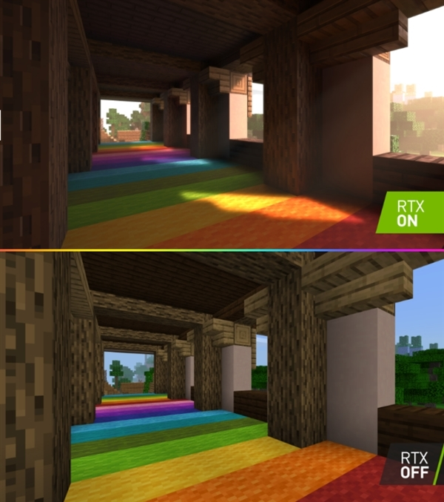
1. What is ray tracing?
Rasterization(before):
For each triangle t
find pixels inside t
shade pixel with its color
Shade till the pixels leave t.
Ray tracing:
For each pixels p
cast a ray through pixel p
shade p
The color is depends on what the Ray intersects with and reflected to.
Minecraft will get ray tracing for Nvidia RTX graphics cards - The Verge
Notes:
Difference:

Slide 6
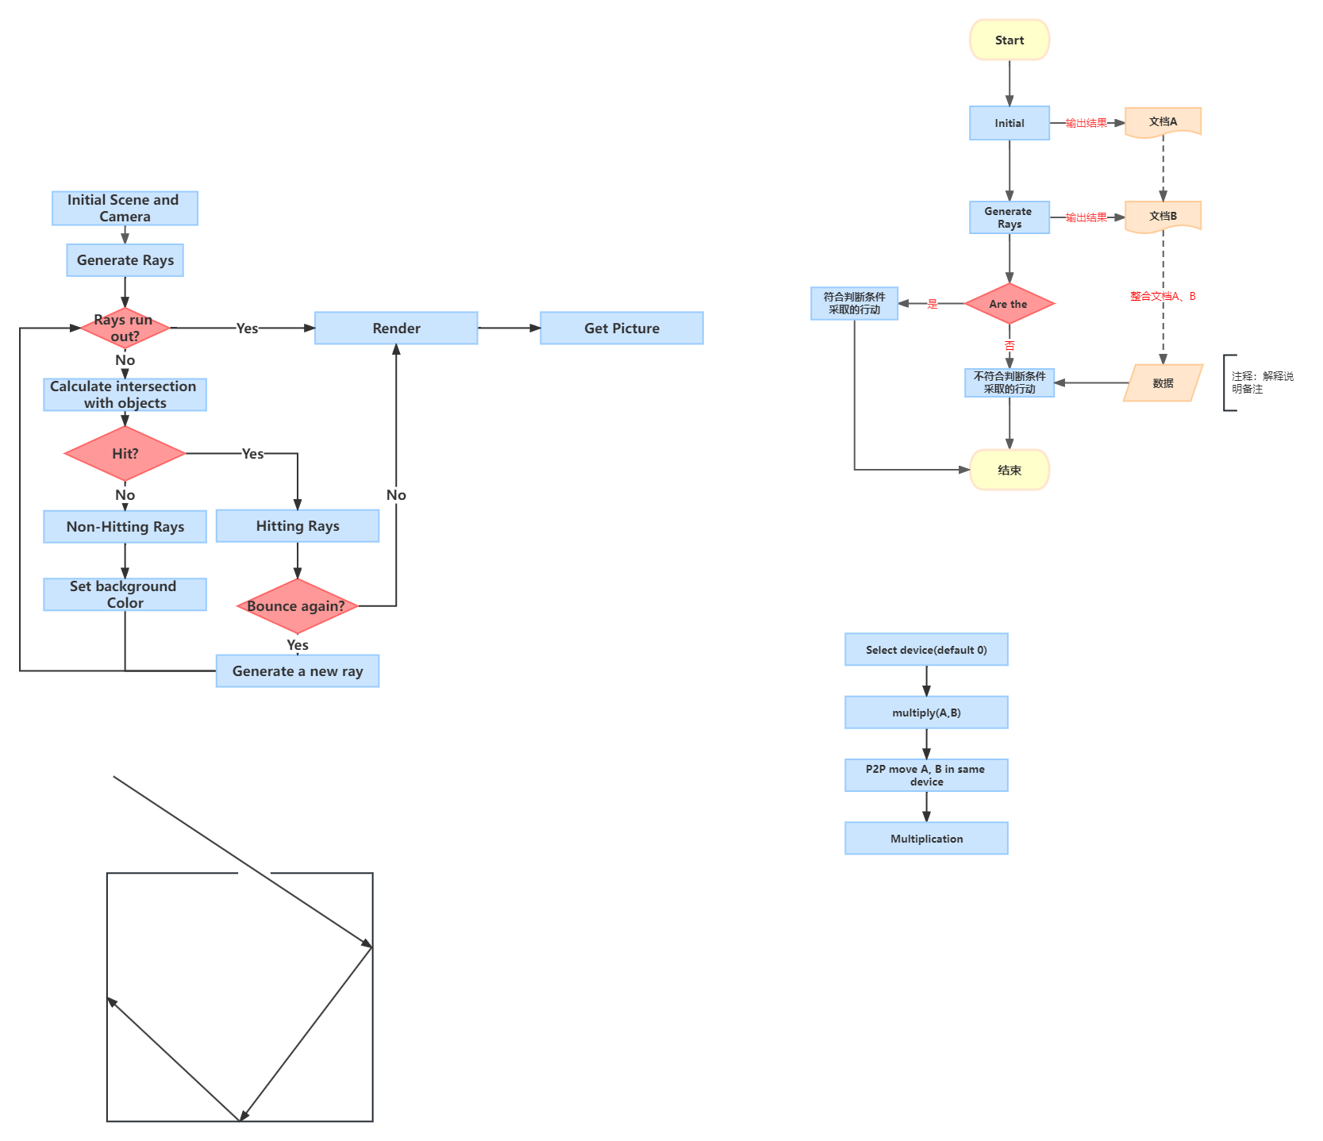
2. Flow Chart
Notes:
Difference:

Slide 7
3. Project Details
01
Generate Rays
02
Intersection
03
Non-Hitting Rays
04
Hitting Rays

Slide 8
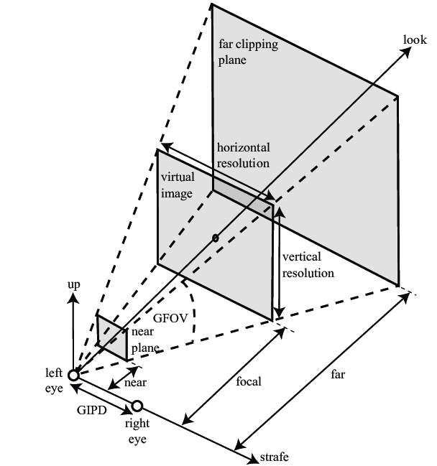
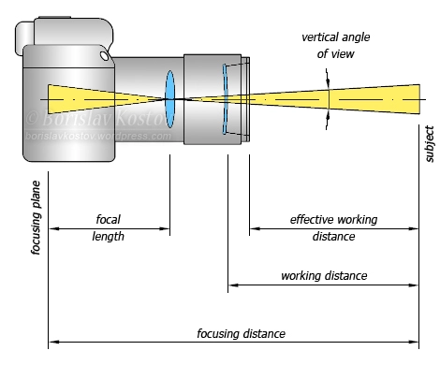
3.1 Generate Rays
Camera Model
Reference: Focal length, focusing distance, working distance | Borislav Kostov - photography and design (wordpress.com)
Reference: Idealized binocular camera model in three-dimensional computer graphics... | Download Scientific Diagram (researchgate.net)

Slide 9
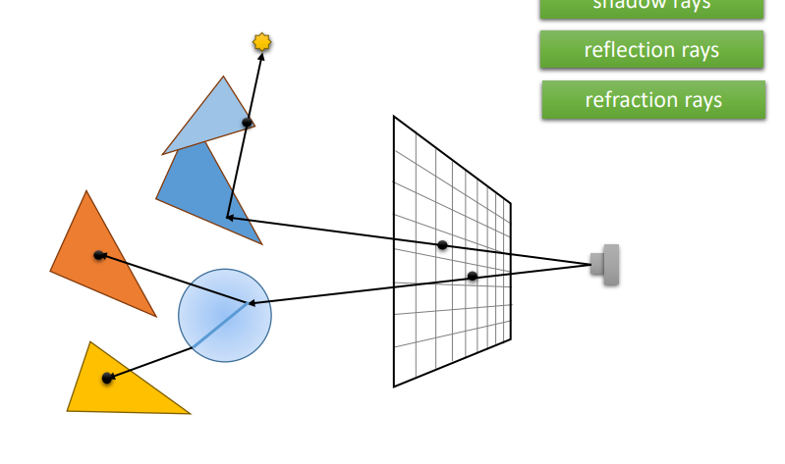
3.1 Generate Rays
Camera Model

Slide 10
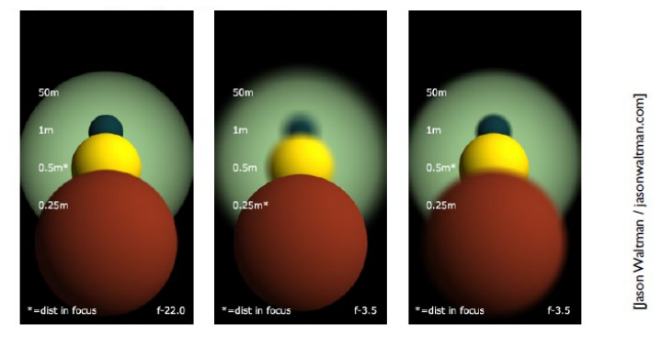
3.1 Generate Rays
Depth of Field

Slide 11
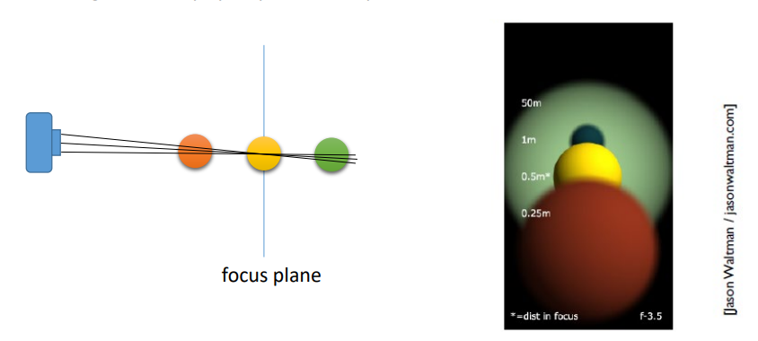
3.1 Generate Rays
Depth of Field

Slide 12
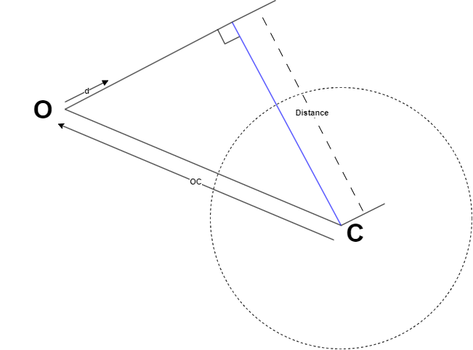
3.2 Intersect
Ray and spheres

Slide 13
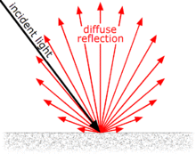
3.2 Intersect
Lambertian Surface
Lambertian Surface:
Ideal rough surface, which can be viewed as the same color in every direction.
Example: paper
In Ray tracing
The color of hit point is decided by the light source surrounding this point.
Implement:
Reflect once in a random direction d, w.r.t cos<d,n> is bigger than 0, where n is the norm vector here.
Picture from: Lambertian reflectance - Wikipedia

Slide 14
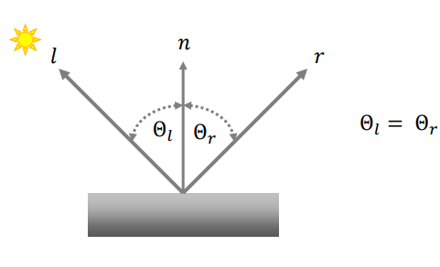
3.2 Intersect
Mirror Surface
Perfect Mirror Surface:
Example: mirror
Realistic Mirror Surface:
Is a little rough and partially diffused reflection
In Ray tracing
Set a roughness parameter to control how smooth the mirror or metal are.
Implement:
Add a noise(roughness x random unit vector) in the direction of reflected ray.
Picture from Computer Graphics slides

Slide 15
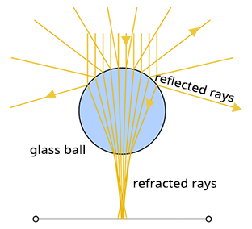
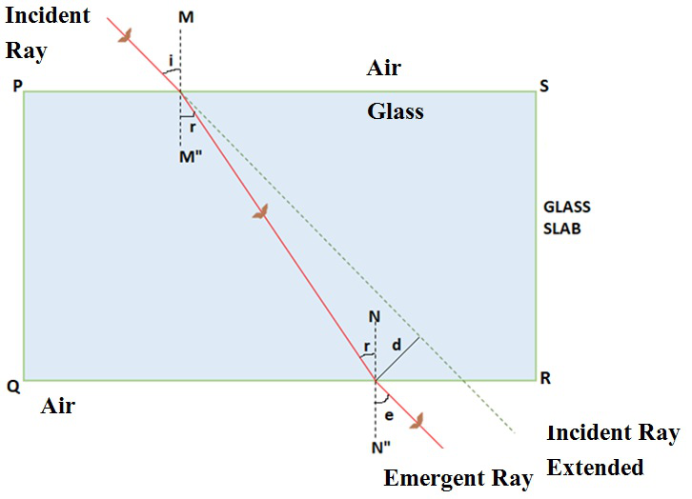
3.2 Intersect
Dielectric Surface
Glass ball:
Rflected rays and refracted rays exist at the same time.
Implement:
By parameter reflection, we can judge how the ray cross the surface(reflection or refraction)
Reflection:
Same to mirror surface
Refraction:
Picture from: Introduction to Raytracing: A Simple Method for Creating 3D Images (scratchapixel.com)

Slide 16

3.3 Non-Hitting Rays
1. Rays don’t intersect with any object
R(t) = point(o) + t * vector(d)
t is larger than Max_Ray_Length, set it background color.
2. Rays bounce too many times
Set it black.

Slide 17
3.4 Hitting Rays
Delete the incident ray
Add the color to the pixel
Add the scatter ray to Collection
Picture from Computer Graphics slides

Slide 18
3. Project Details
Notes:
Difference:

Slide 19

4. GPU Acceleration
4.1 Numpy
What‘s numpy?
a = [1, 2, 3]
an = numpy(a)
print(a+1) # illegal in python
print(an + 1) # good in numpy
Numpy is designed for numerical data in Python. Numpy API is used extensively in Pandas, Scipy, Matplotlib, scikit-learn, scikit-image and most other data science and scientific Python packages.
Accerated by
implementing operation in C.
Contiguous block of memory.
NumPy: the absolute basics for beginners — NumPy v1.25 Manual

Slide 20
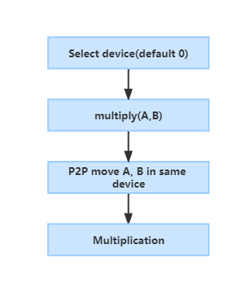

4. GPU Acceleration
4.1 Cupy or Numpy
Use Cupy instead of numpy
Cupy is a GPU array backend that implements Numpy interface.
In most situation, just change numpy.array() to cupy.array()

Slide 21
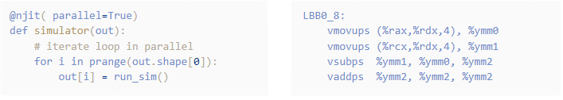
4. GPU Acceleration
4.2 Numba
Numba translate Python into machine code
By using LLVM compiler library, Python original interpreter is removed.
It can realize 2-100 times faster than Numpy on CPU.
Numba supports Intel, AMD x86, ARM GPUs, NVIDIA GPUs, Windows/macOS/Linux.

Slide 22
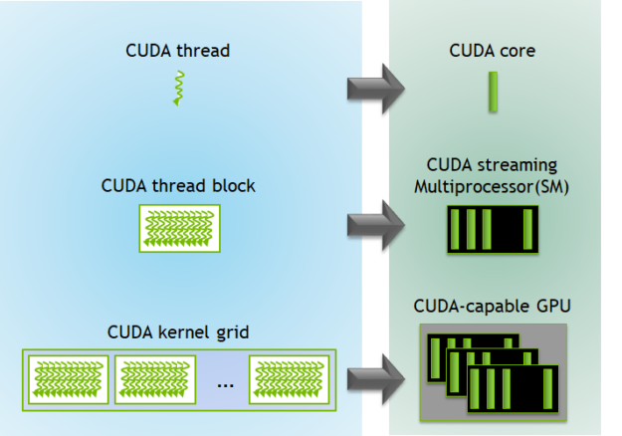
4. GPU Acceleration
4.2 Numba
Thread per block = 32 * 16 #blocks = 64*64 Chunk = 2^20
SM count: 30 CUDA cores per SM: 64 RTX 2060
Image from CUDA Refresher: The CUDA Programming Model | NVIDIA Technical Blog

Slide 23
4. GPU Acceleration
4.2 Numba
If grid size(#blocks) and block size(#threads) is not good, CPU gets busy on transfering data and GPU has low occupancy
Image from CUDA Refresher: The CUDA Programming Model | NVIDIA Technical Blog

Slide 24
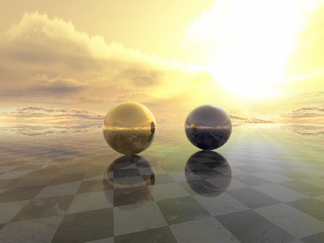
Ray Tracing with sightpy Library – A Coding Journey

Slide 25
5. sightpy Library
5.1 Code Flow
Following is the code flow:
Import ‘sightpy’ library
Define the materials
Render the scene
Create a new scene

Slide 26
5. sightpy Library
5.2 Features
A powerful Python tool.
Simplifies the implementation of ray tracing projects.
The collection of classes and functions.
Handles ray generation, intersection testing, and shading computations.

Slide 27
5. sightpy Library
5.3 Materials
gold_metal and bluish_metal.
Type "Glossy" materials.
Shiny, reflective surfaces.
The floor material is also of type "Glossy" but uses an image texture ("checkered_floor.png").
gold_metal = Glossy(diff_color = rgb(1., .572, .184), n = vec3(0.15+3.58j, 0.4+2.37j, 1.54+1.91j), roughness = 0.0, spec_coeff = 0.2, diff_coeff= 0.8) # n = index of refraction bluish_metal = Glossy(diff_color = rgb(0.0, 0, 0.1), n = vec3(1.3+1.91j, 1.3+1.91j, 1.4+2.91j), roughness = 0.2,spec_coeff = 0.5, diff_coeff= 0.3)
floor = Glossy(diff_color = image("checkered_floor.png", repeat = 80.), n = vec3(1.2+ 0.3j, 1.2+ 0.3j, 1.1+ 0.3j), roughness = 0.2, spec_coeff = 0.3, diff_coeff= 0.9 )

Slide 28
5. sightpy Library
5.4 Scene Creation Pipeline
Set up the camera
Add light
Add shapes
Add plane
Add background image

Slide 29
5. sightpy Library
5.5 Camera Setup
A camera is added to the scene with the specified look_from, look_at positions
The dimensions of the camera's image plane (400x300 pixels
angle = -np.pi/2 * 0.3 Sc.add_Camera(look_from = vec3(2.5*np.sin(angle), 0.25, 2.5*np.cos(angle) -1.5 ), look_at = vec3(0., 0.25, -3.), screen_width = 400 , screen_height = 300)

Slide 30
5. sightpy Library
5.6 Light Setup
A directional light source is added to the scene with direction and colour.
A directional light emits parallel rays of light, simulating sunlight.
Sc.add_DirectionalLight(Ldir = vec3(0.52,0.45, -0.5), color = rgb(0.15, 0.15, 0.15))

Slide 31
5. sightpy Library
5.7 Objects
Two spheres and a plane.
Each object is associated with a material, positions, sizes.
Sc.add(Sphere(material = gold_metal, center = vec3(-.75, .1, -3.),radius = .6, max_ray_depth = 3)) Sc.add(Sphere(material = bluish_metal, center = vec3(1.25, .1, -3.), radius = .6, max_ray_depth = 3)) Sc.add(Plane(material = floor, center = vec3(0, -0.5, -3.0), width = 120.0,height = 120.0, u_axis = vec3(1.0, 0, 0), v_axis = vec3(0, 0, -1.0), max_ray_depth = 3))

Slide 32
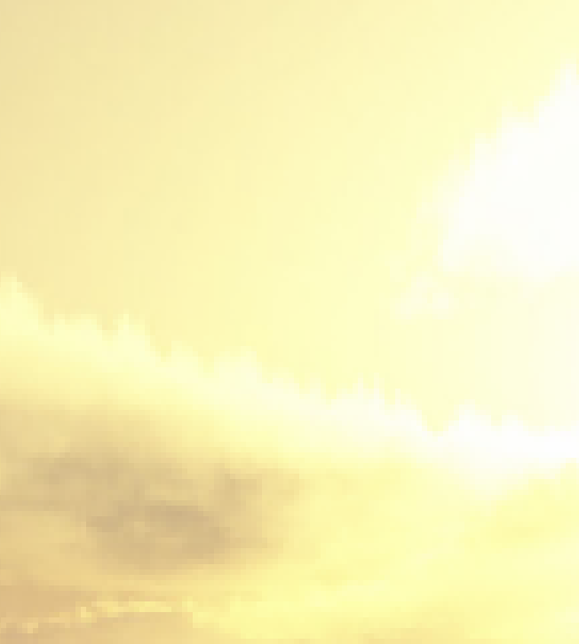
5. sightpy Library
5.8 Background
("stormydays.png")
Provides the environment for the ray tracing.
Sc.add_Background("stormydays.png")

Slide 33
5. sightpy Library
5.9 Rendering
The render() method is called on the Scene object to generate the image.
The parameter samples_per_pixel=6 controls the number of samples per pixel
Used for antialiasing and improving image quality.
img = Sc.render(samples_per_pixel = 6)

Slide 34
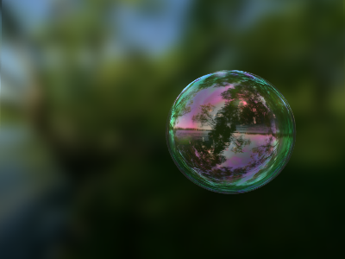
Classes in sightpy Library
A Brief Explanation

Slide 35
5. sightpy Library
5.10 Glossy
Here's a brief explanation of the code for the Glossy class:
Class Definition: Used to define materials for objects in the ray tracing scene.
Constructor: The __init__ method initializes the Glossy material with specific attributes like diff_color, roughness, spec_coeff, diff_coeff, and n (index of refraction).
Color Calculation: The get_color method calculates the color of the intersected object based on its material properties and the lighting conditions in the scene.
Diffuse Reflection: Calculates the amount of light reflected by the surface based on the angle between the surface normal and the light direction.
Shadow Handling: The code checks if the intersected point is in shadow or not.
Reflection Handling: The code handles reflections by tracing rays from the intersected point in the reflected direction and calculating the color contribution from the reflected ray.
Fresnel Factor: Controls the amount of light reflected and transmitted at the intersection point.
Surface Nudging: A small offset is added to the intersection point to avoid self-intersections when calculating reflections.

Slide 36
5. sightpy Library
5.11 Camera
Represents the virtual camera in the ray tracing scene.
Key aspects of the Camera class include:
Attributes: screen_width, screen_height, look_from, look_at, field_of_view, aperture, and focal_distance.
Camera Reference Basis: The camera's reference basis in world coordinates is defined using the cameraFwd, cameraRight, and cameraUp vectors.
Pixel Coordinates: Casts rays from the camera to the scene.
get_ray: This method generates a ray from the camera's position and direction.

Slide 37
5. sightpy Library
5.12 Lights
The lights.py file contains the Light class and its subclasses, PointLight and DirectionalLight, representing light sources in the ray tracing scene.
Light Class: The Light class is an abstract base class that defines common attributes and abstract methods for light sources.
PointLight Class: The PointLight subclass represents a point light source and implements methods like get_L, get_distance, and get_irradiance.
DirectionalLight Class: The DirectionalLight subclass represents a directional light source, which emits light in a specific direction. It also implements methods like get_L, get_distance, and get_irradiance.

Slide 38
5. sightpy Library
5.13 Sphere
Represents a sphere object in the ray tracing scene.
Constructor: The __init__ method initializes the Sphere object with attributes such as center, material, radius, max_ray_depth, and shadow.
Collider Initialization: Creates a Sphere_Collider object and adds it to the collider_list for intersection testing.
UV Mapping: The method get_uv is used to get the texture coordinates (u, v) of the hit point on the sphere's surface. It calculates the phi and theta angles based on the hit point's position.
Sphere_Collider Class: Represents the collider for the sphere object.
Intersection Test: Tests the intersection between a ray (O, D) and the sphere collider. It calculates the discriminant and determines if the ray intersects with the sphere. If it intersects, it returns the hit distance h and the hit orientation.
Normal Calculation: Calculates the surface normal at the intersection point (hit point) on the sphere. It returns the normalized vector from the sphere's center to the hit point.
UV Calculation: Calculates the texture coordinates (u, v) for the hit point on the sphere's surface using phi and theta angles.

Slide 39
5. sightpy Library
5.14 Plane
Represents a plane object in the ray tracing scene.
Constructor: Initializes the Plane object with attributes such as center, material, width, height, u_axis, v_axis, max_ray_depth, and shadow.
Collider Initialization: Creates a Plane_Collider object and adds it to the collider_list for intersection testing.
UV Mapping: The method get_uv is used to get the texture coordinates (u, v) of the hit point on the plane's surface. It calculates the u and v coordinates based on the hit point's position and the u and v axes.
Plane_Collider Class: Represents the collider for the plane object.
Intersection Test: The intersect method tests the intersection between a ray (O, D) and the plane collider. It calculates the intersection point M and the distance dis from the ray origin to the intersection point. Checks if the intersection point is inside the plane's boundaries and whether the ray direction is upwards or downwards.
Rotation: The rotate method allows rotating the plane collider around a specified center point using a transformation matrix M.
Normal Calculation: Returns the normal vector of the plane's surface, which is precalculated during initialization.

Slide 40
5. sightpy Library
5.16 Render
Contains functions for rendering images and implementing path tracing for the ray tracing project:
trace_ray Function: Calculates the intersection between a ray and objects in the scene and returns the position and normal of the hit.
trace_ray_material Function: Similar to trace_ray but also returns emission.
sample_sphere and sample_hemisphere Functions: Used for sampling points on a sphere and hemisphere, respectively, which are useful for path tracing.
to_image Function: Converts a numpy array or vec3 buffer to a PIL Image, allowing visualization of the rendered scene.
render_path_tracing and render_path_tracing_MIP_lambert Functions: These functions implement path tracing for the ray tracing scene, where samples are traced through the scene to compute the final image color.

Slide 41
5. sightpy Library
5.17 Ray
Contains the Ray and Hit classes, essential for ray-object intersection and tracing. Let's explore these classes:
Ray Class: Represents a ray in the scene and includes attributes like origin, direction, depth, n (index of refraction), reflections, transmissions, and diffuse_reflections.
Hit Class: Stores information about the intersection between a ray and a surface, including distance, orientation, material, collider, and surface properties.
get_raycolor Function: Traces rays in the scene and computes the color contribution from each intersected object based on material properties.

Slide 42
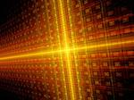
Results Comparison
This Photo by Unknown Author is licensed under CC BY-NC-ND

Slide 43
6 Comparison & Summary
6.1 Cupy vs Numpy

Slide 44
Contd.

Slide 45
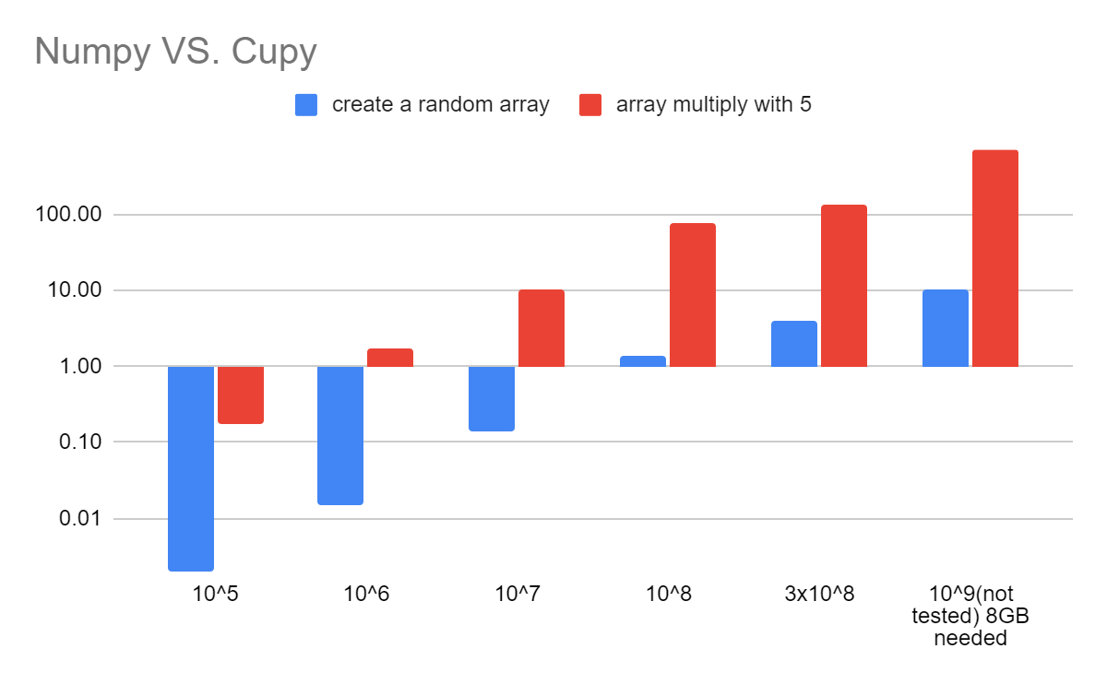
Contd.
714.10
133.08
78.69
1.73
10.10
4.06
10.50
1.36
0.18
0.14
0.015
0.002
Time consume of Numpy
Data tested by Haopeng
Chart created by Haopeng
Time consume of Cupy

Slide 46
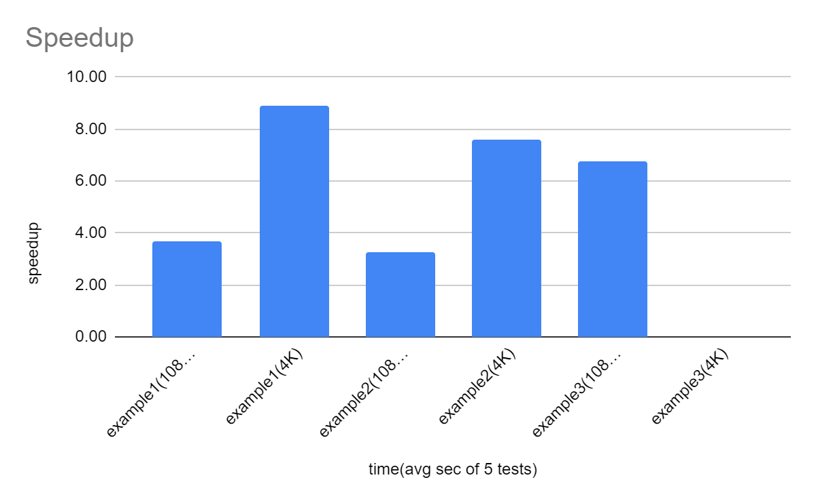
Contd.
time(avg sec of 5 test) | numpy | cupy | speedup
example1(1080P) | 13.84 | 3.69 | 3.69
example1(4K) | 13.71 | 3.72 | 8.92
example2(1080P) | 30.21 | 9.72 | 3.25
example2(4K) | 151.09 | 19.96 | 7.60
example3(1080P) | 14.64 | 2.09 | 6.78
example3(4K) | 53.78 | unk. | unk.
Implementation environment:
GPU: RTX 2060 (6GB) CPU: i5-9400F RAM: 32GB OS: Ubuntu 22.04.2 LTS

Slide 47
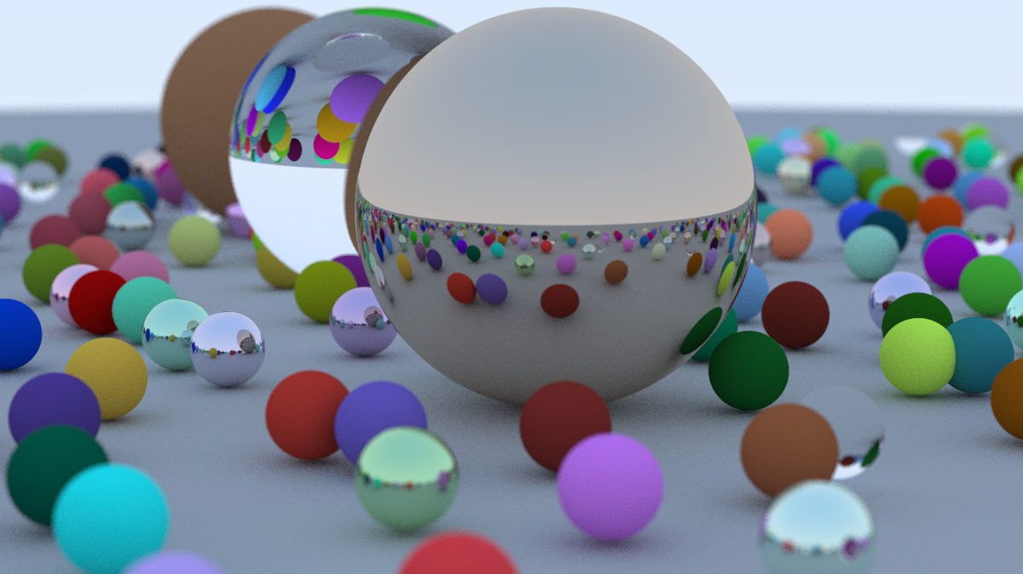
6 Comparison & Summary
6.2 Numba
It need around 4 hours when on CPU.
CUDA implementation takes less than 1 minute.
(resolution: 1200x675)
Implementation environment:
GPU: RTX 2060 (6GB) CPU: i5-9400F RAM: 32GB OS: Ubuntu 22.04.2 LTS

Slide 48
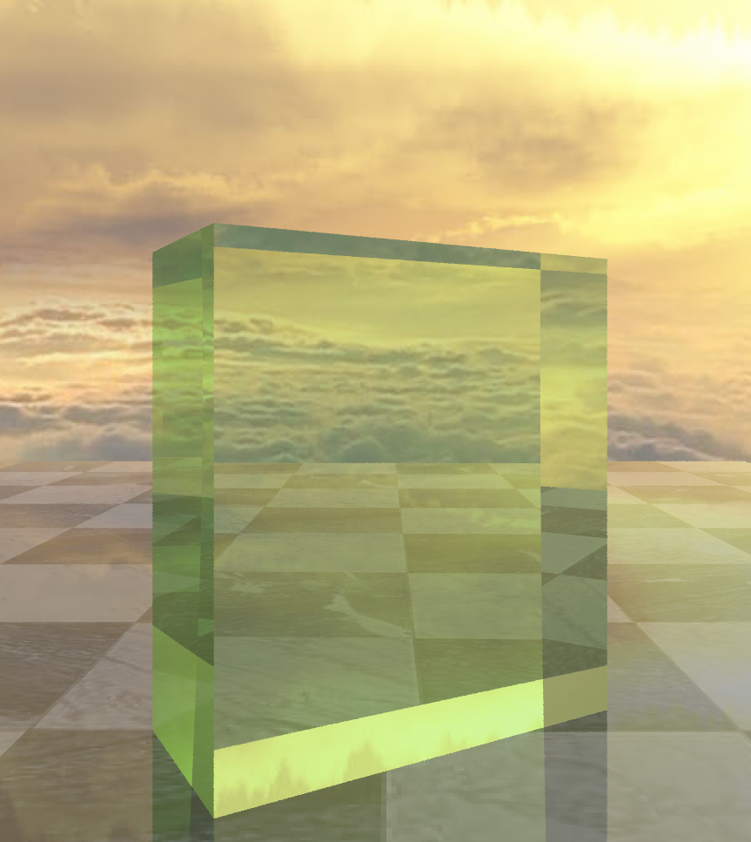
6. Comparison & Summary
6.3 Summary
Python is interpreted language and C is compiled language
For better performance, need to go deeper to compiler and machine language
Accelerate by using Bounding Volume Hierarchy
Know more about how RTX cores works
Adjust parameters for different hardwares
sightpy library simplifies ray tracing implementation

Slide 49
7. Reference
Computer Graphics slides from Professor Stamminger and Dr. Grosso
sightPy – github.com
Python-ray-tracing-with-cuda-example – github.com
Numba documentation — Numba 0.52.0.dev0+274.g626b40e-py3.7-linux-x86_64.egg documentation (pydata.org)
Contents — CUDA C Programming Guide (nvidia.com)
CuPy – NumPy & SciPy for GPU — CuPy 12.1.0 documentation
NumPy: the absolute basics for beginners — NumPy v1.25 Manual
J Turner Whitted explains how he stumbled into global illumination – CGPress
Minecraft will get ray tracing for Nvidia RTX graphics cards - The Verge

Slide 50
Thank You!

